Slide 1
Structure of a Cold Front

Slide 2
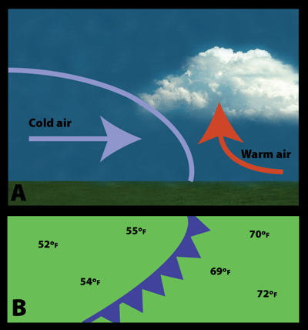
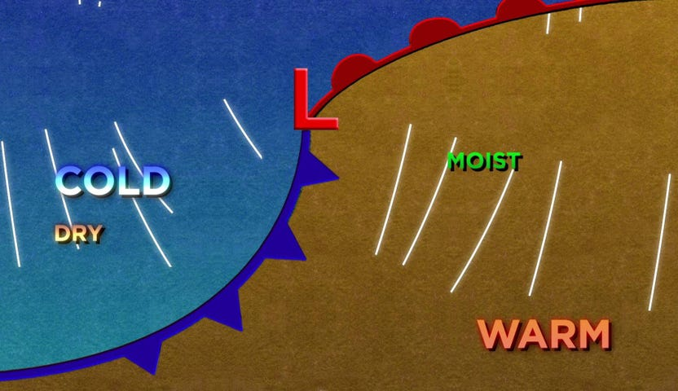
What is a Cold Front?
A cold front occurs when a cold air mass moves into a warm air mass.

Slide 3
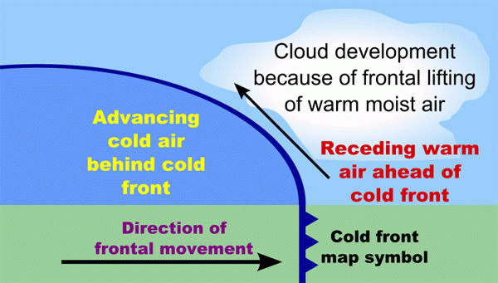
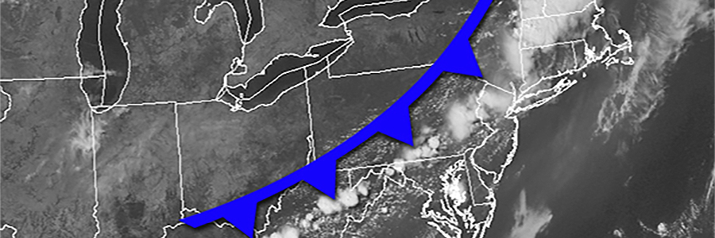
Structure of a Cold Front
Cold fronts have a steep vertical slope as cold air moves into warmer air, leading to strong vertical temperature gradients.

Slide 4
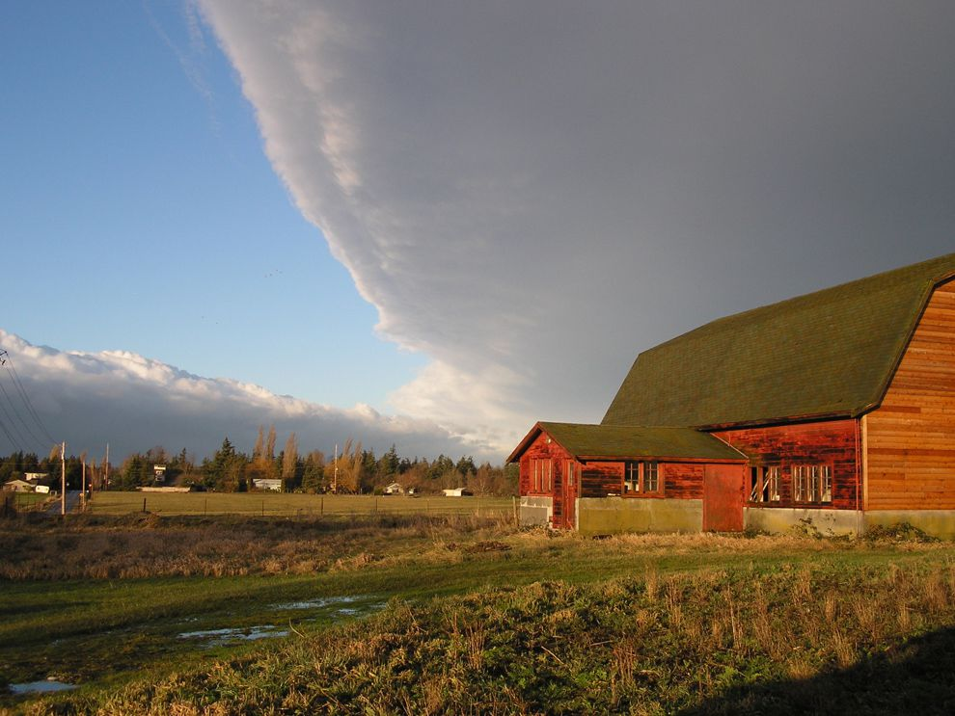
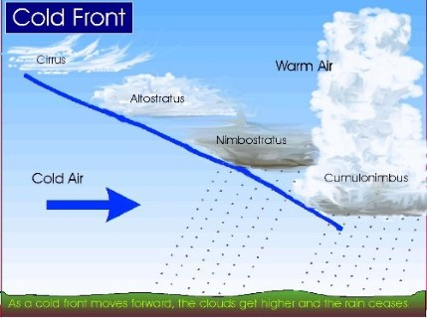
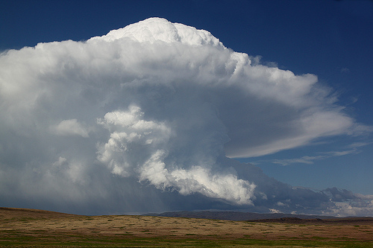
Clouds and Precipitation
Cold fronts are usually characterized by convective clouds and precipitation.
Often associated with severe thunderstorms and heavy rainfall.
Clouds are called “cumuliform” due to their large vertical extent.

Slide 5
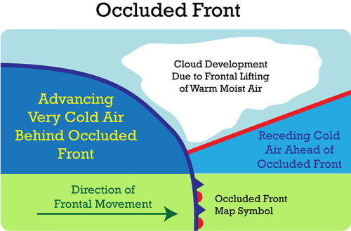
Occluded Fronts
When warm and cold fronts combine, they form an occluded front.

Slide 6
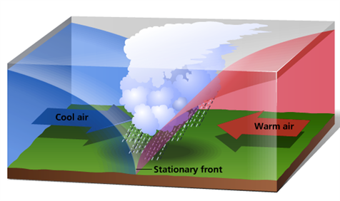
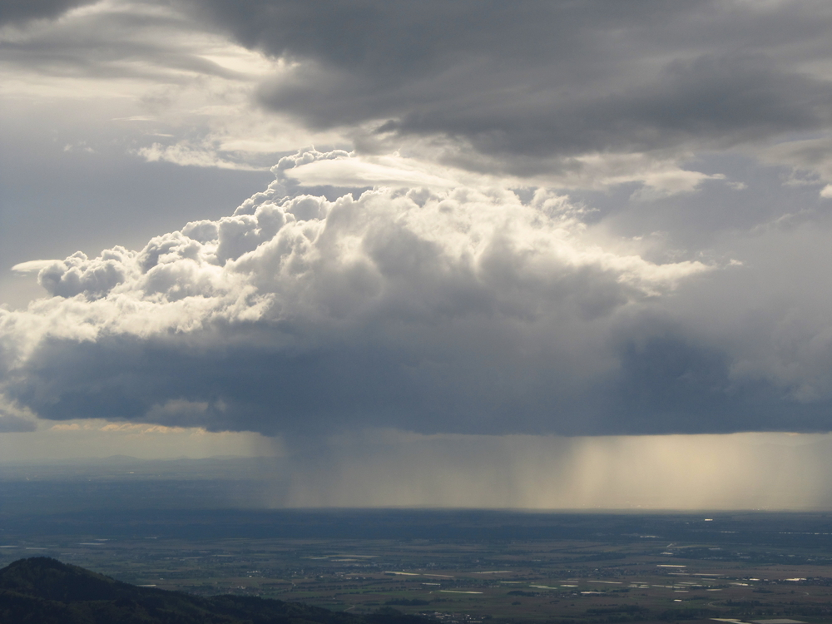
Stationary Fronts
When one air mass stops moving into another air mass, the boundary is called a stationary front.
Often associated with flooding since the precipitation tends to stay over the same area.

